Slide 1
Unsupervised Learning
Unsupervised Learning
F i n a l P r o j e c t
Unsupervised approaches for Khmer word and speaker gender discrimination
Presented By
Chanmann Lim
Fernando Torre
Chanmann Lim, and Fernando Torre

Slide 2
Agenda
Problem & Motivation
Dataset
Our Proposal
Methods
Results and Conclusions

Slide 3
Agenda
Problem & Motivation
Dataset
Our Proposal
Methods
Results and Conclusions

Slide 4
Problem and Motivation
80% of technological progress is done in less than 5% of the world languages.
Low-resourced languages continue to lack behind new innovation adaptation and advantages.
The goal of our project is:
Investigate various unsupervised methods on words clustering task for Khmer language

Slide 5
Agenda
Problem & Motivation
Dataset
Our Proposal
Methods
Results and Conclusions

Slide 6
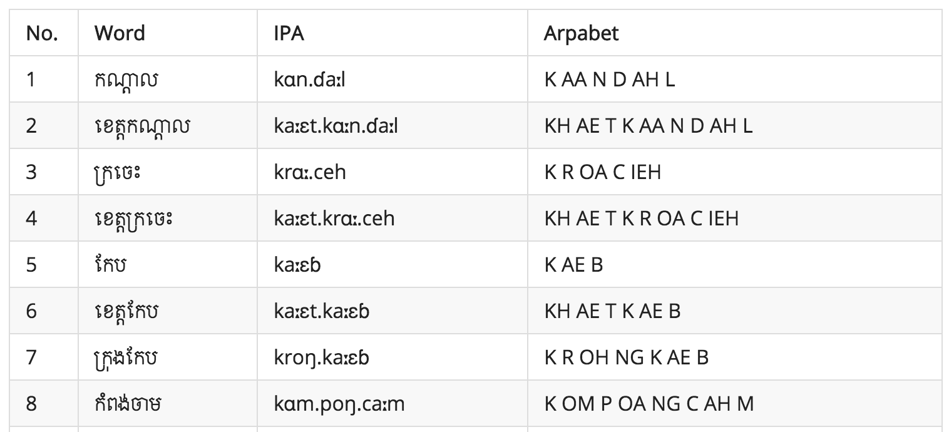
Dataset
Institute of Technology of Cambodia. “Khmer Keywords IPA and Arpabet Transcription” http://khmerasr.github.io/blog/2015/06/12/khmer-keywords-ipa-and-arpabet-transcription/
10 speakers (5 males & 5 females) aged between 19 & 23
103 words/speaker
recorded with phone headset

Slide 7
Agenda
Problem & Motivation
Dataset
Our Proposal
Methods
Results and Conclusions

Slide 8
Pre-processing
Clustering algorithms
Evaluation
MFCCs feature extraction
Distance matrix with Dynamic Time Warping
Hierarchical Clustering
K-Medoids clustering
Fuzzy C-Medoids clustering
Spectral clustering + K-means
Normalized Mutual Information
Naive Count Accuracy
Transcription comparison

Slide 9
Agenda
Problem & Motivation
Dataset
Our Proposal
Methods
Results and Conclusions

Slide 10
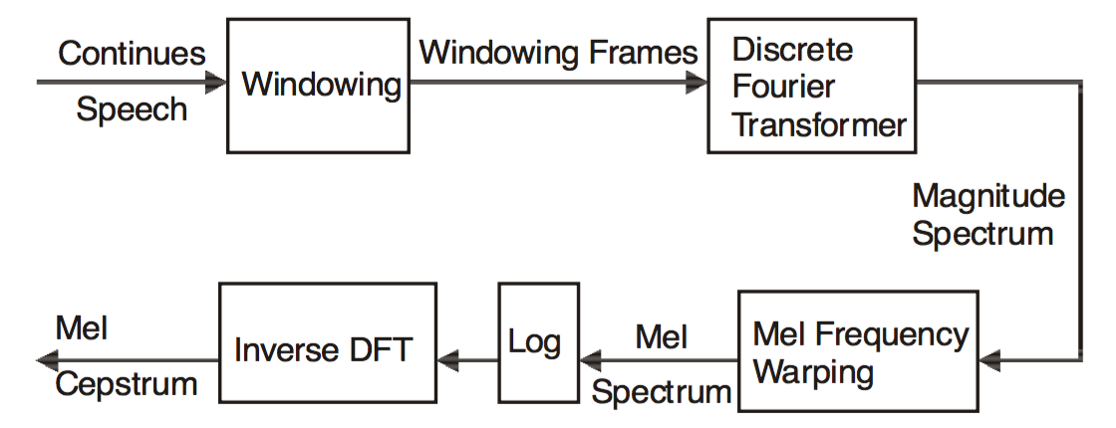
Feature Extraction
Spectral analysis
Courtesy of Vibha Tiwari - “MFCC and its applications in speaker recognition”
13-dimension MFCCs (Mel-Frequency Cepstral Coefficients)
zscore normalization

Slide 11
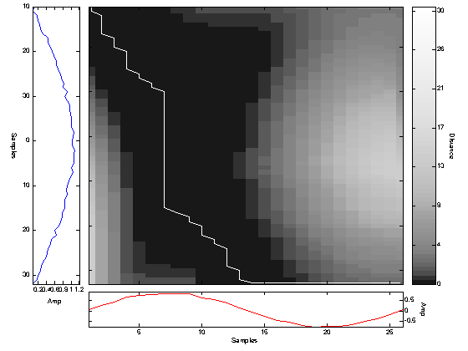
Dynamic Time Warping (DTW)
Compare two sequences with different length
then normalize the distance by it warping path

Slide 12
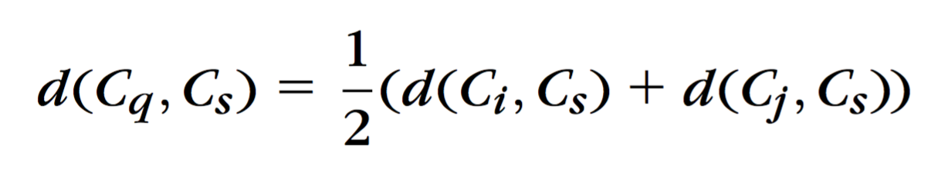
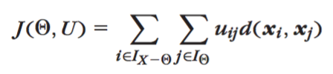
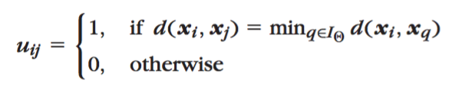
Hierarchical Clustering
K-Medoids Clustering
WPGMA (weighted pair group method with averaging)
Randomly initialize k medoids
Iteratively swap the medoid to minimize the cost function

Slide 13
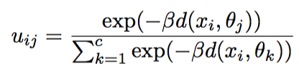
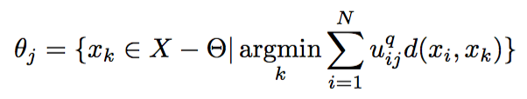
Fuzzy C-Medoids
Probabilistic membership
𝛽 is parameters that reflect the size of the clusters.
Update medoid by

Slide 14
Spectral clustering + K-means
Spectral clustering + K-means
Spectral clustering for dimension reduction
Then perform K-means
Choose ϵ to achieve 10% sparseness
Fix ϵ, choose σ² that gives the highest NMI
Normalize the quantized components

Slide 15
Agenda
Problem & Motivation
Dataset
Our Proposal
Methods
Results and Conclusions

Slide 16
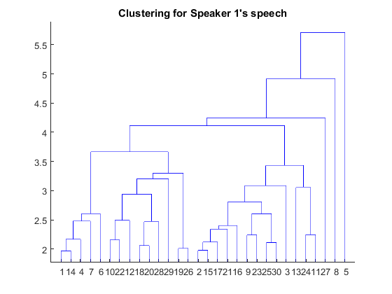
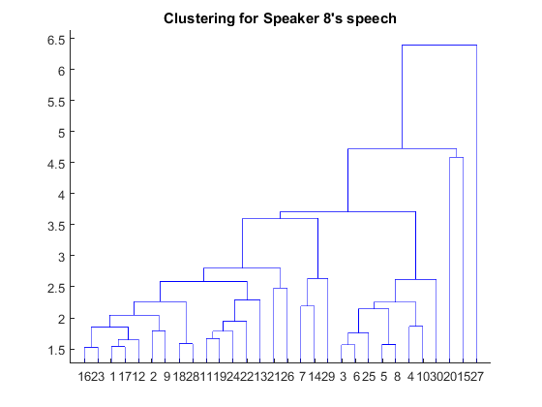
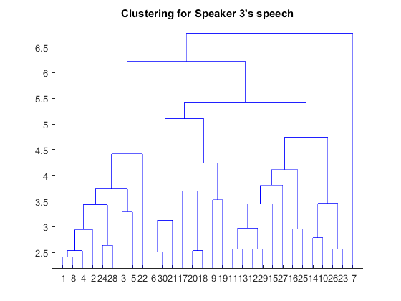
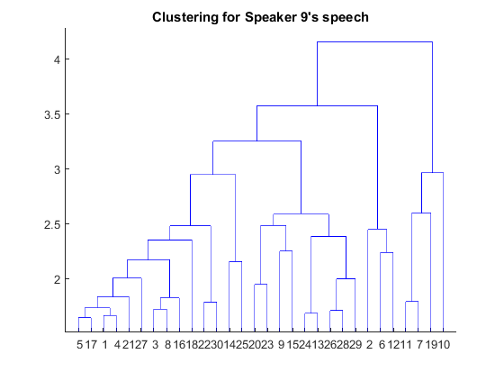
Hierarchical Clusterings

Slide 17
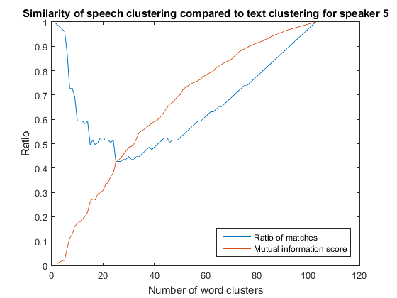
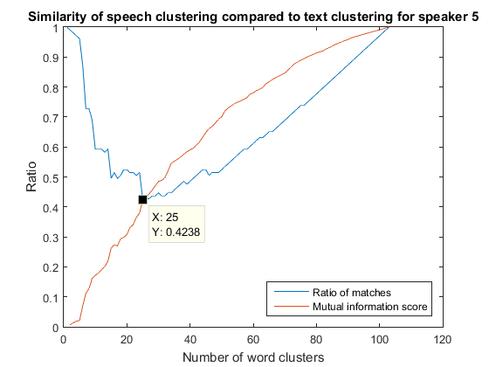
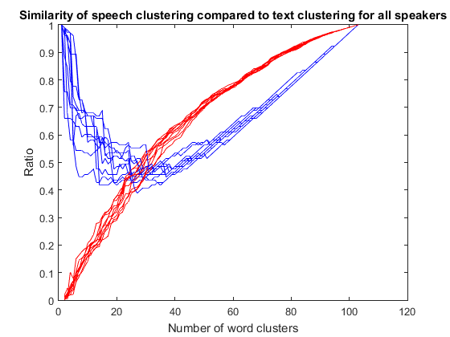

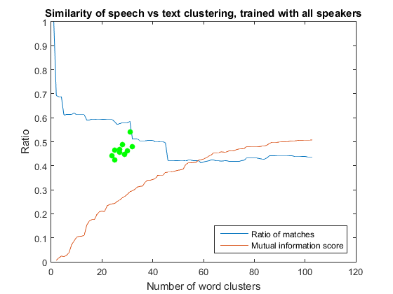
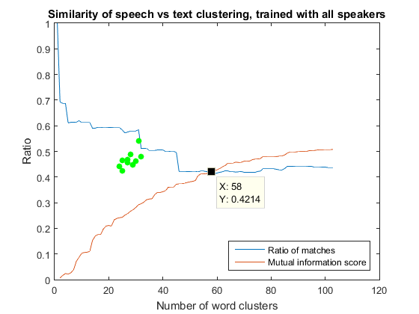
Transcription Comparison

Slide 18
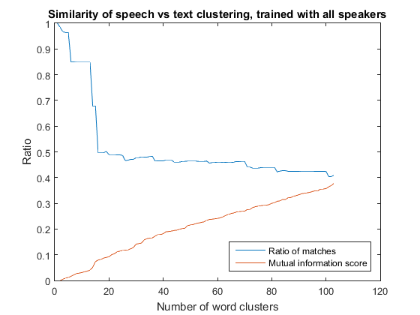
Transcription Comparison

Slide 19
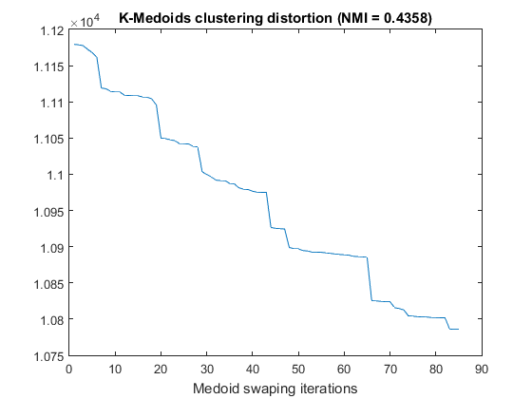
K-Medoids

Slide 20
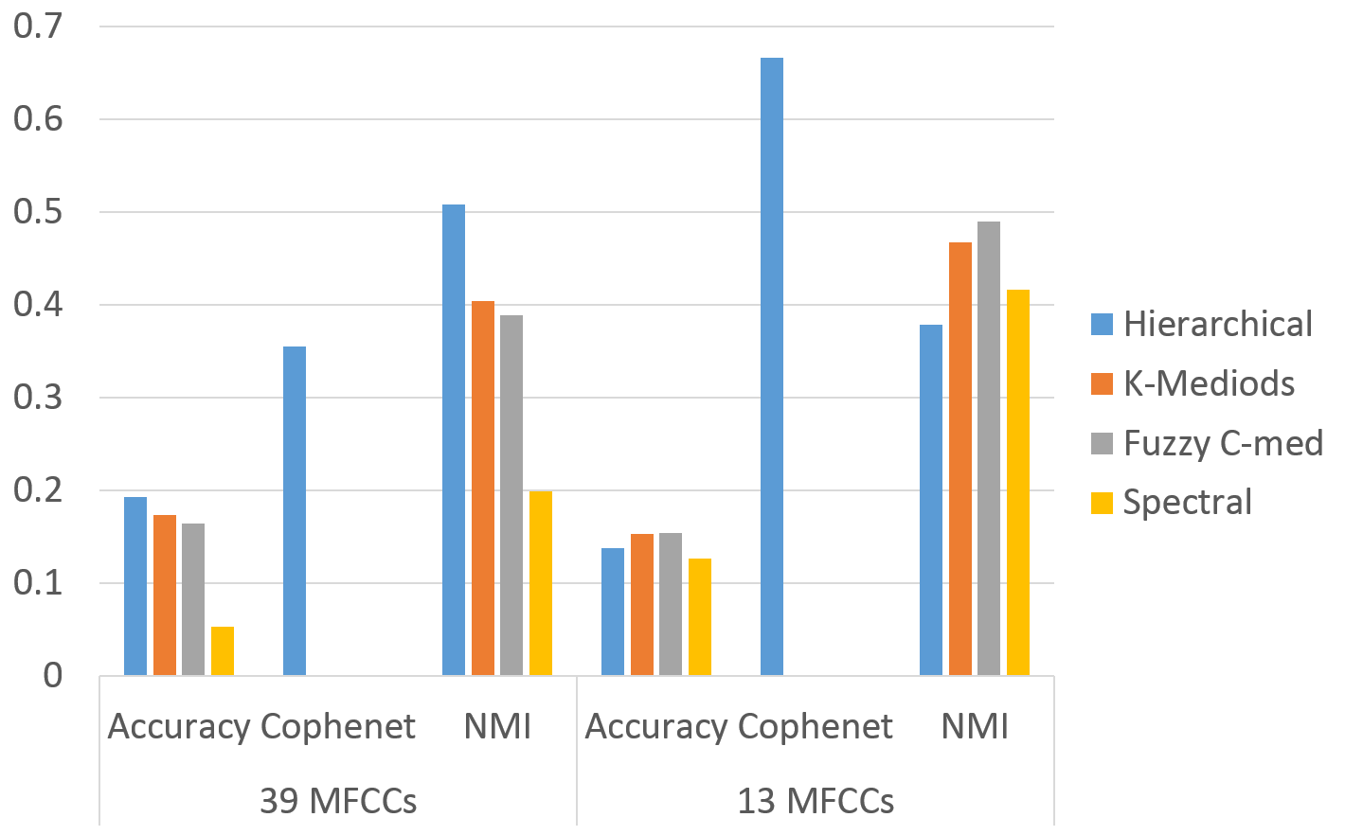
Comparison of Clustering Methods for Word Identification

Slide 21
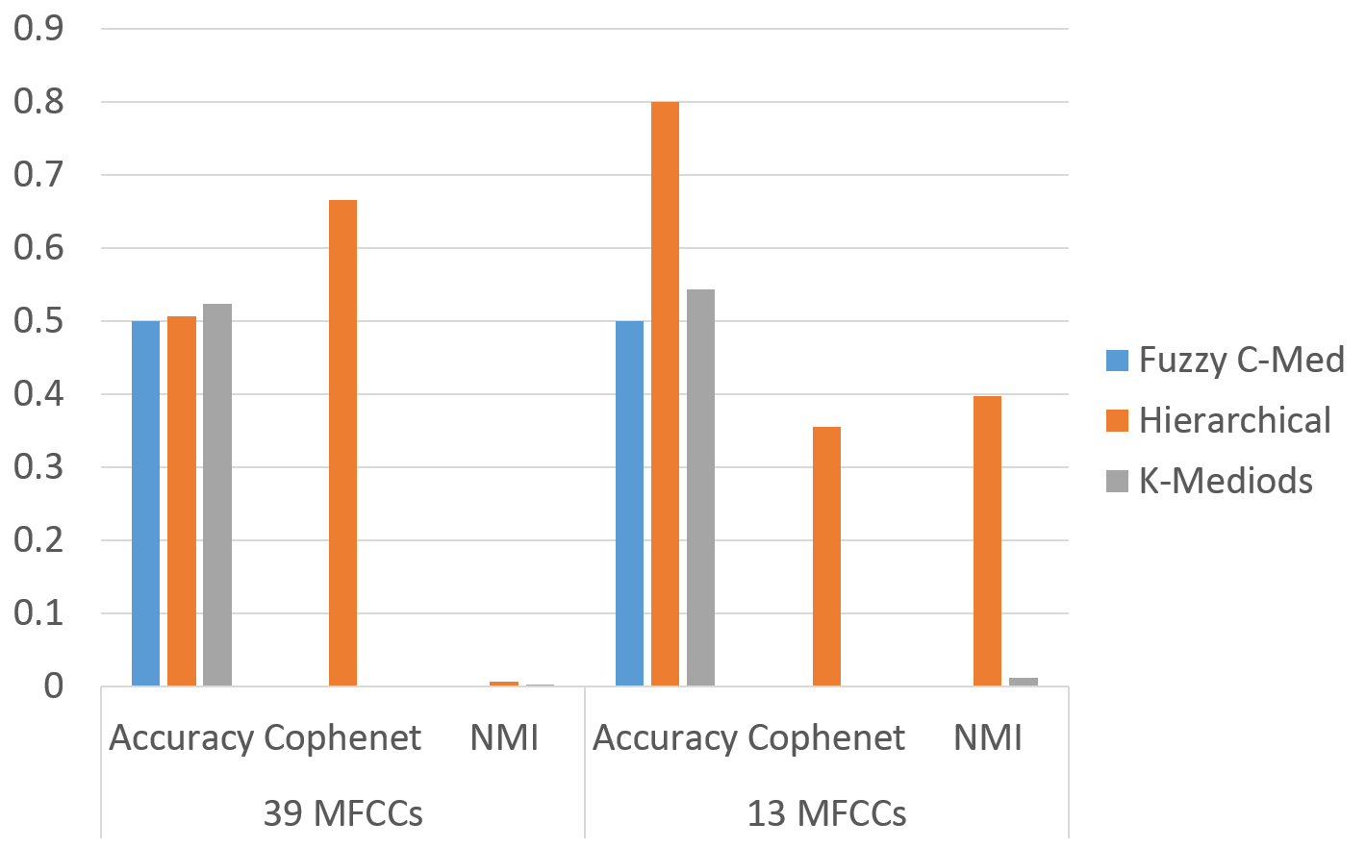
Comparison of Clustering Methods for Gender Identification

Slide 22
Conclusion
Normalized DTW offers a means for clustering experimentation for speech data
Gender, speaker characteristics and emotion, words similarity and recording condition play major role in speech variabilities
It’s hard to generalize acoustic discovery using purely unsupervised methods

Slide 23
Future Work
Label words by linguistic family (e.g. root or part of speech) and evaluate clustering using that
Smaller acoustic unit (Phoneme) with context-dependent Hidden-Markov Model

Slide 24
Thank You
Any Question?

